Slide 1
ACRL New England – May 13, 2016
GreenGlass Group Functionality
Ruth Fischer, Sustainable Collection Services
GreenGlass Product Manager and EAST Analyst

Slide 2
GreenGlass video tutorials:
http://www.oclc.org/sustainable-collections/resources.en.html#tutorials

Slide 3
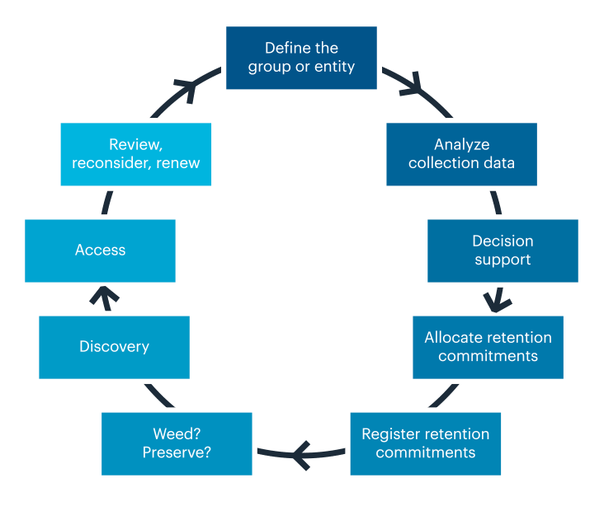
Shared Print Workflow
Notes:
This circle-chart provides an overview of the shared-print workflow as we currently understand it – again focusing on monographs. Starting at 12 noon, a group must come together and agree to collaborate. At 1 o’clock quite a bit of heavy lifting is needed in terms of data collection, synchronization and analysis. Only then, can decisions be made about the components of a shared-print agreement. After that, retention commitments can be allocated to participant libraries - and then actions taken to protect and register them. Finally at seven o’clock – member libraries can safely weed surplus copies.
GreenGlass is an OCLC web application – that offers a substantial number of shared-print features for monographs. Functionality is now in place - to support the first six steps in this shared-print workflow.

Slide 4
Shared Print: Retention First!
Establish a safety net: ensure that all titles are secure
Group-wide agreement on retention models
Group-wide commitment to retention rules & duration
Secure scarcely-held titles within the group
Secure sufficient holdings of each titles to satisfy likely user demand
Share responsibility for retention proportionately
Deselection only after retention commitments established
Notes:
I want to emphasize that all of our tools and services for group projects - prioritize RETENTION. Creating the safety net always comes first.

Slide 5
GreenGlass Group Functionality
GreenGlass Group functionality employs data visualizations and modeling tools to enable groups of libraries to:
understand their shared collection in terms of overlap, age, and usage.
experiment with various retention scenarios, and estimate the impact on each participant library.
commit to specific retention agreements, with confidence in the outcome.
Notes:
For most groups seeking to share responsibility for their print monographs collections, the biggest problems stem from the fact that very few people have done this before - and basic concepts are not familiar. Therefore, we’ve designed GreenGlass to help participants learn about important characteristics of the shared collection and to have enough information to engage in strategic conversations about how to move forward. GreenGlass provides data visualization and a data modeling tools to achieve these goals.

Slide 6
Group collection visualizations
in greenglass
Notes:
(Breath.)

Slide 7
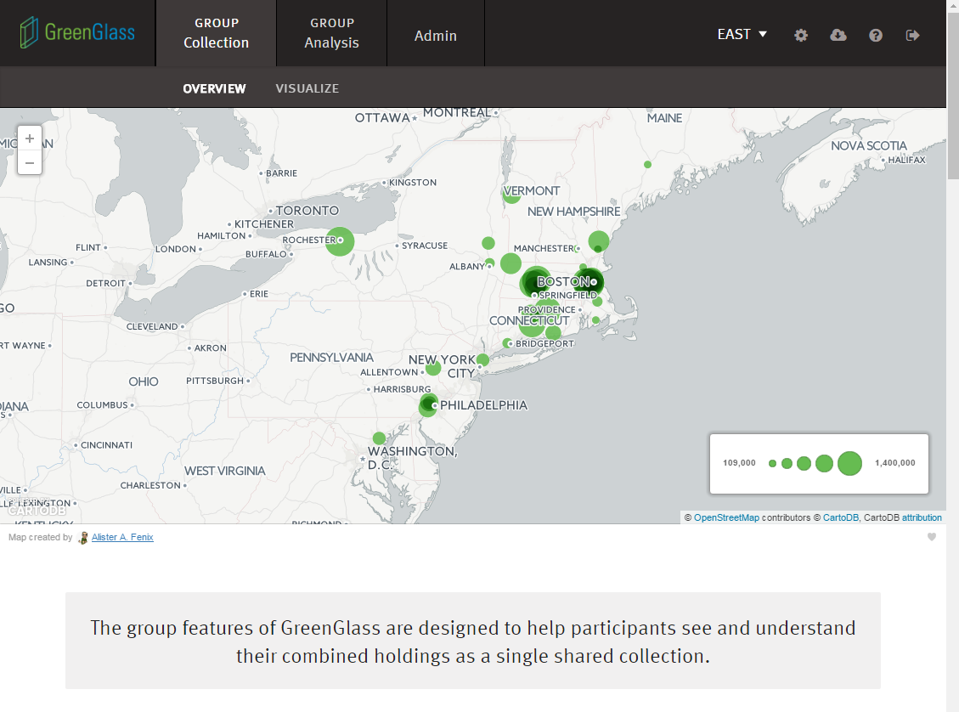
Notes:
Group visualizations in GreenGlass transform huge amounts of disparate collections data - into interactive displays – designed to help users understand the nature of the shared collection --- AND their own library’s position in it.
Most of the screen shots we’ll see today are from the EAST project pages of GreenGlass.

Slide 8
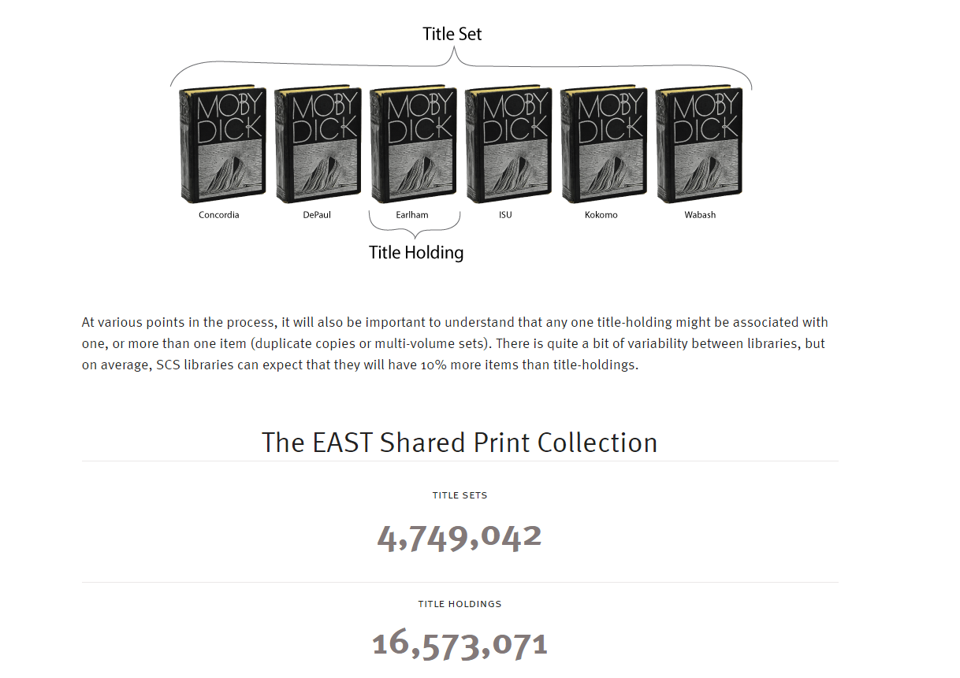
Notes:
Group visualizations in GreenGlass transform huge amounts of disparate collections data - into interactive displays – designed to help users understand the nature of the shared collection --- AND their own library’s position in it.
All of the screen shots we will see today show MI-SPI collection data. MI-SPI is a group of 8 libraries in Michigan (as you can see) – for whom we have recently loaded their shared collection data into GreenGlass. Thank you MI-SPI! For allowing us to show off your data!

Slide 9
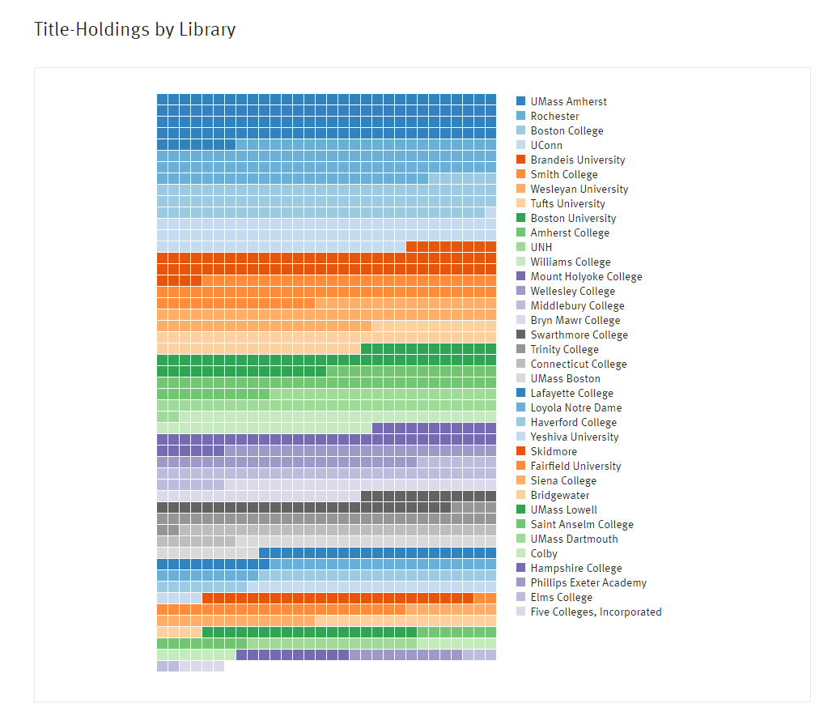
Notes:
Group visualizations in GreenGlass transform huge amounts of disparate collections data - into interactive displays – designed to help users understand the nature of the shared collection --- AND their own library’s position in it.
All of the screen shots we will see today show MI-SPI collection data. MI-SPI is a group of 8 libraries in Michigan (as you can see) – for whom we have recently loaded their shared collection data into GreenGlass. Thank you MI-SPI! For allowing us to show off your data!

Slide 10
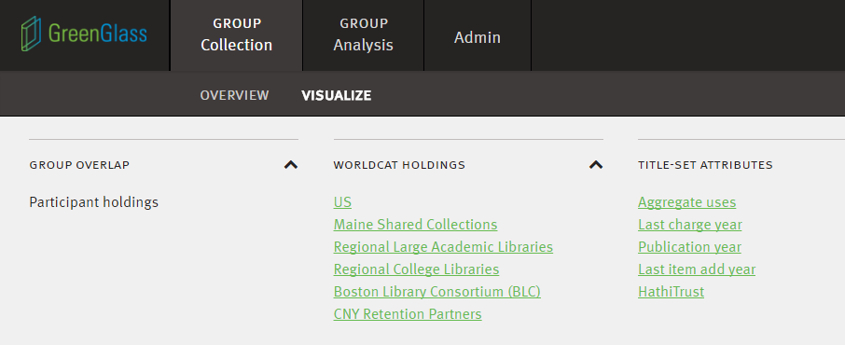
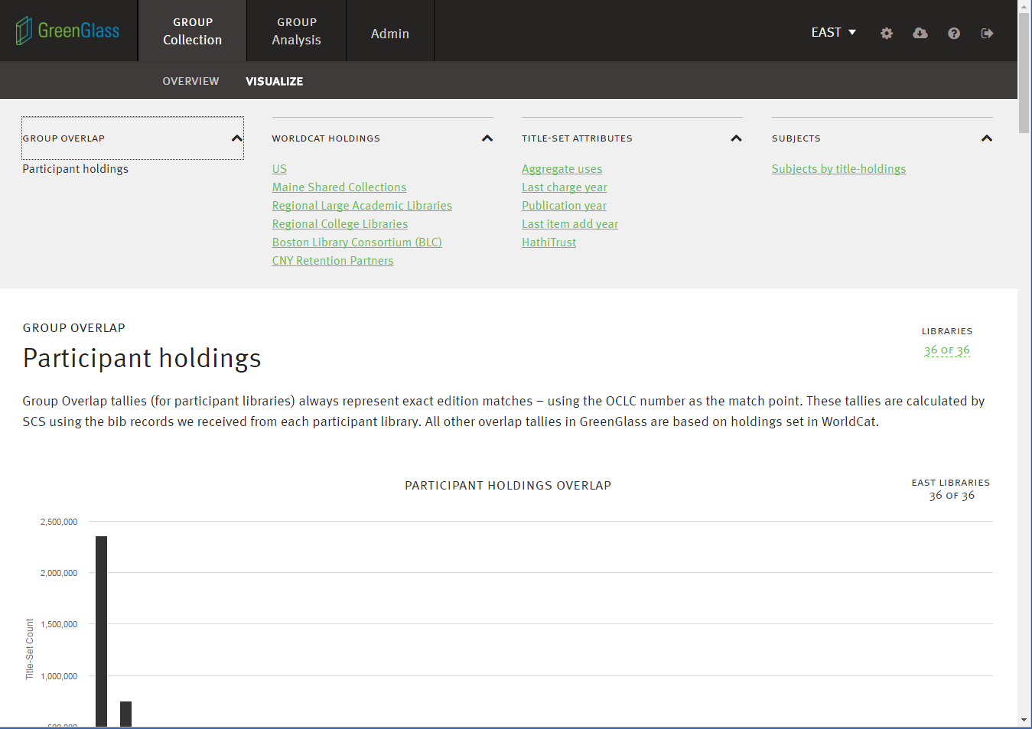
Notes:
The green hyperlinks that you see here represent the most critical collection attributes. Each has a dedicated page in GreenGlass - with interactive charts and explanatory text.
Again, the effort we’ve put into these explanatory pages is meant to help group participants gain a really solid understanding. For example – The extent to which titles are widely or scarcely held, cannot be understood with a single metric. Overlap within the group is one perspective, which we address in depth. But the extent of holdings in the country, the state, and in external comparator groups can be essential to good decision-making. Each of these kinds of overlap, is addressed separately in GreenGlass.

Slide 11
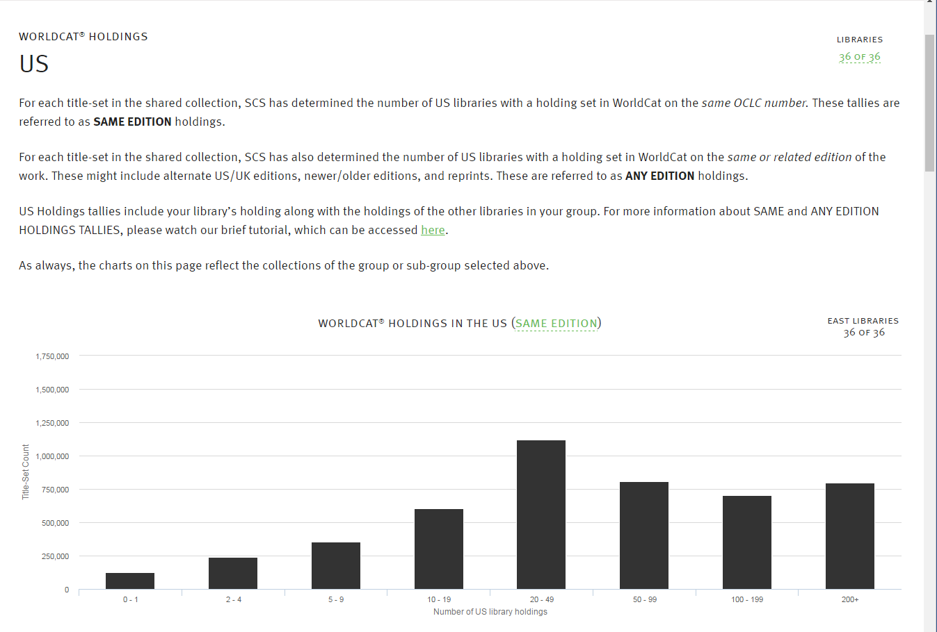
SAME EDITION OVERLAP TALLIES IN THE US
Notes:
And we go further. With regard to holdings overlap, it’s important for participant libraries to understand the relationship between SAME …. [CLICK]

Slide 12
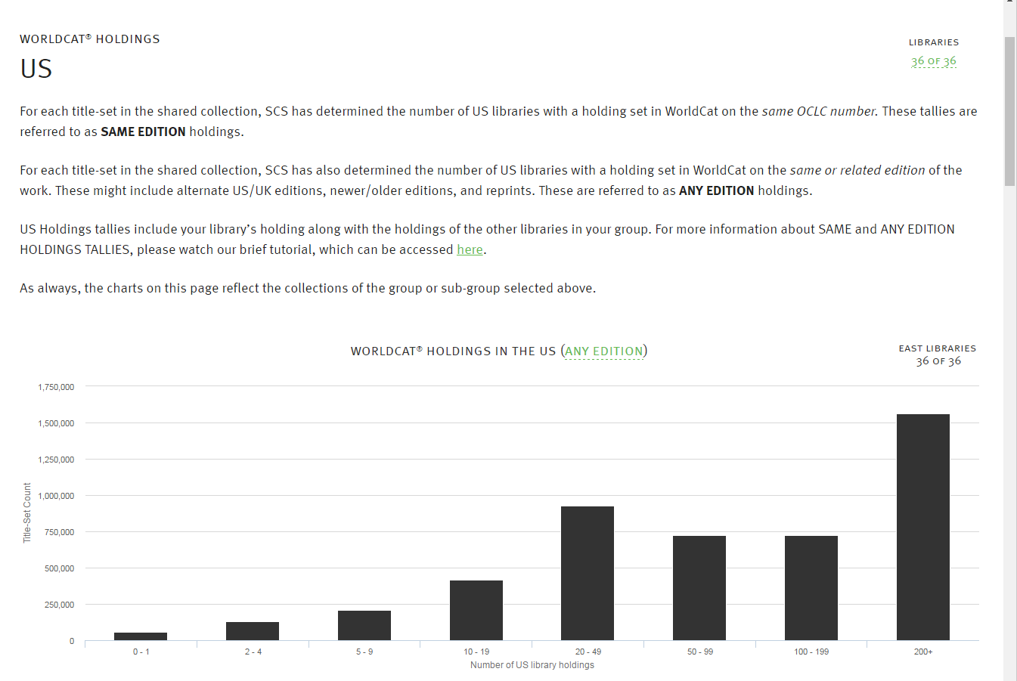
ANY EDITION OVERLAP TALLIES IN THE US
Notes:
… and ANY edition tallies --- so we’ve created an interactive tool that lets users explore this relationship.

Slide 13
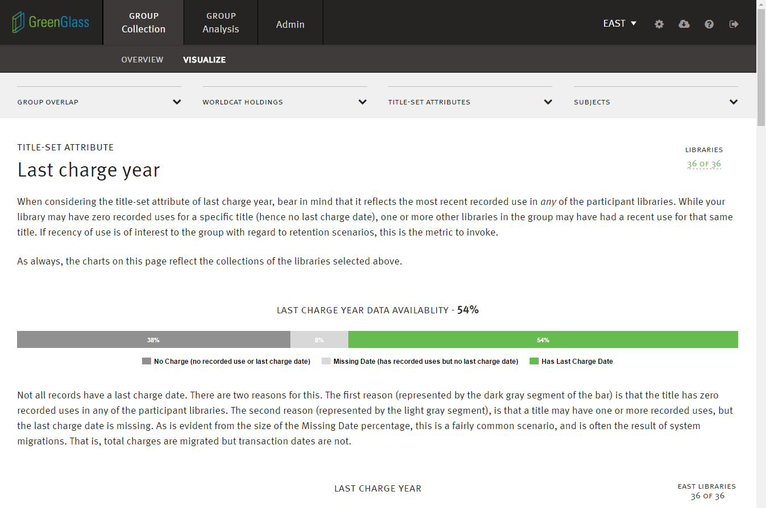
Notes:
It’s also important for group members to understand (for example) the number of recorded uses for each title, but also whether or not specific titles are of current interest to users. This page helps users understand the way in which GreenGlass measures recency of use, and the extent of relevant data available. As we scroll down the page on this topic, we see several views of usage data, for the group collection as a whole … like this

Slide 14
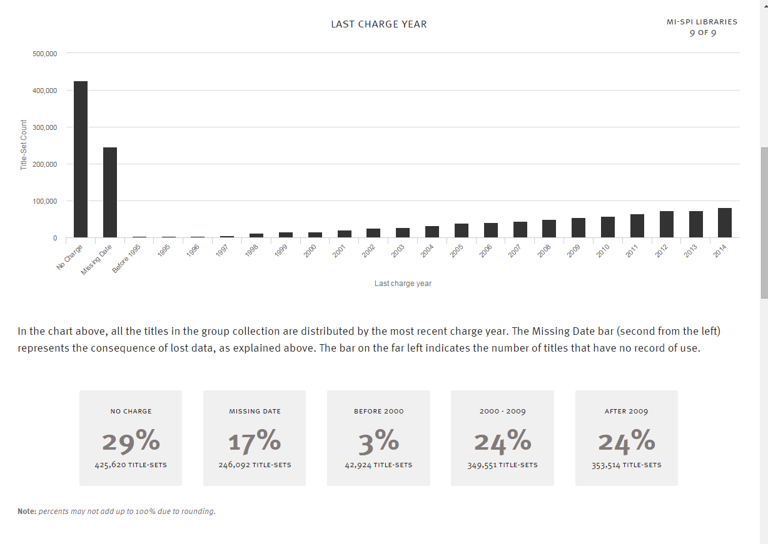
LAST CHARGE YEAR
Notes:
.. and this …

Slide 15
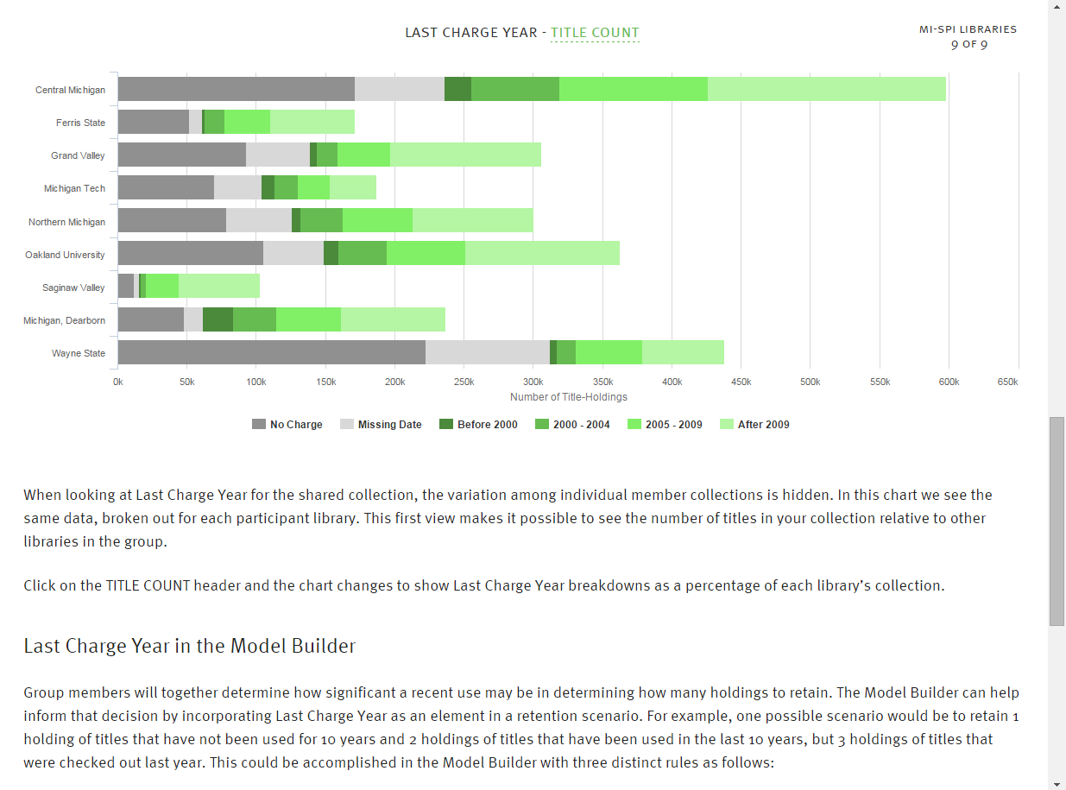
LAST CHARGE YEAR BY TITLE COUNT
Notes:
… AND for each participant library. This graph shows circulation time frames for each library – by title count, and also by …

Slide 16
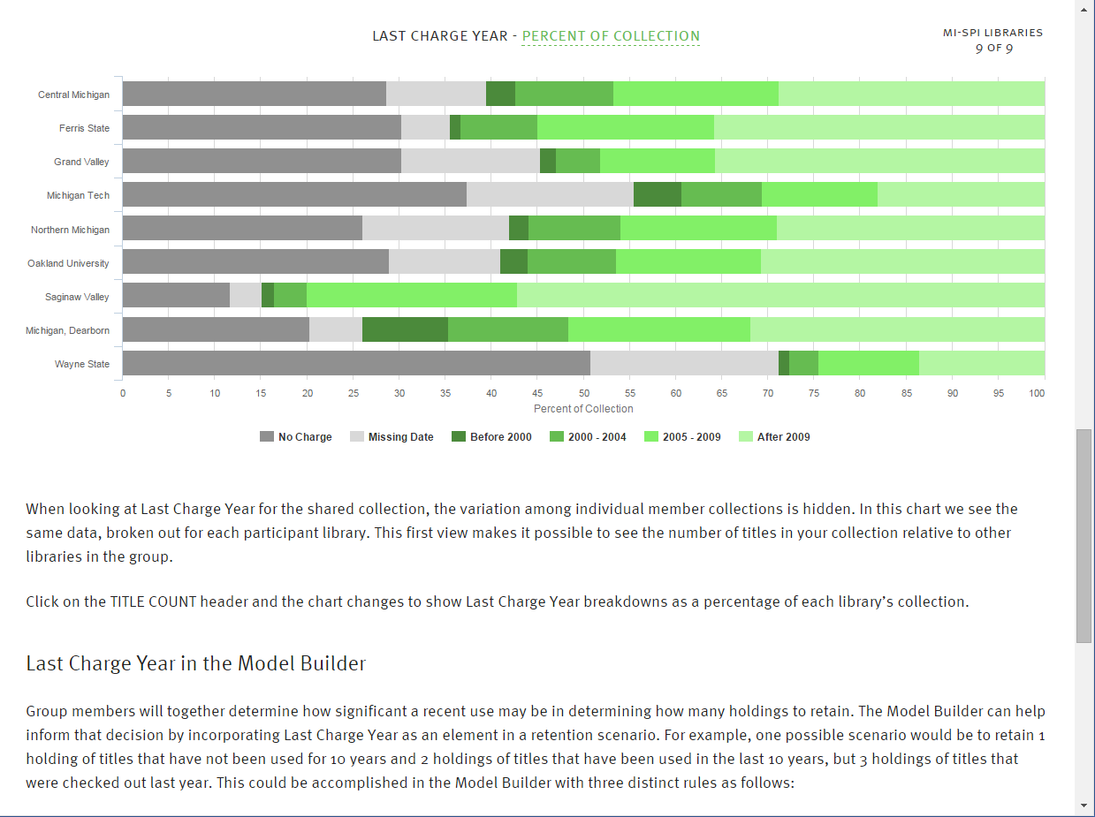
LAST CHARGE YEAR BY PERCENT OF COLLECTION
Notes:
… percent of collection.

Slide 17
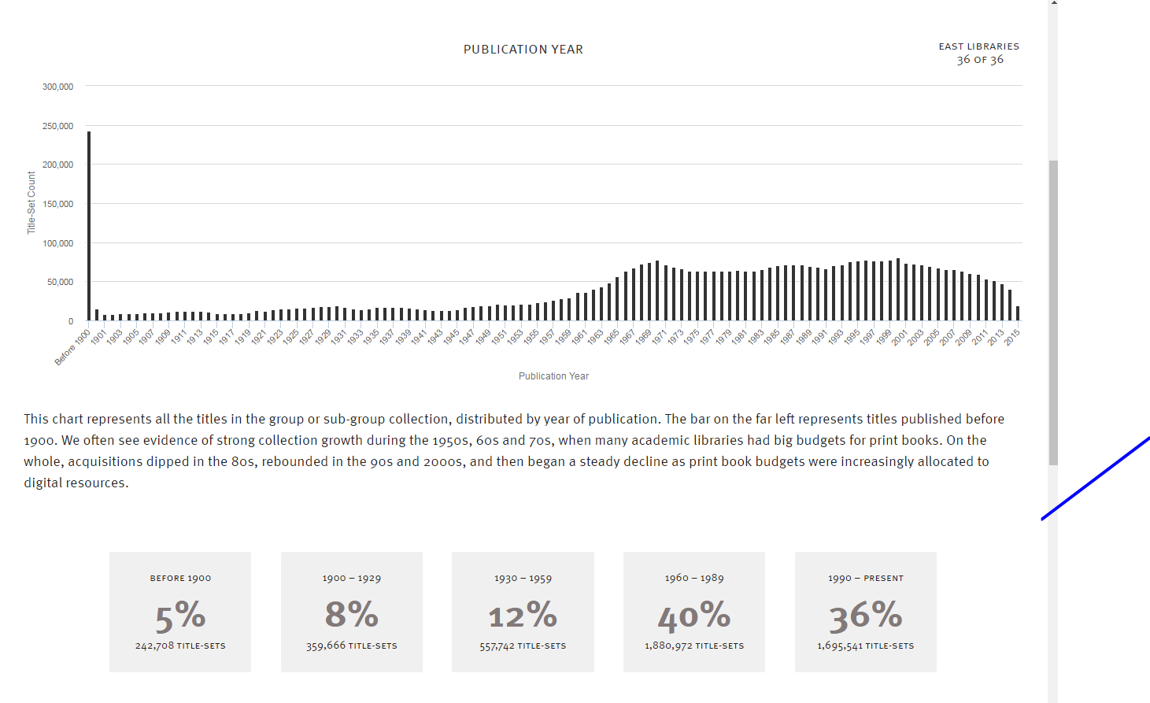
TITLE COUNT BY YEAR OF PUBLICATION
Notes:
… percent of collection.
Once users understand each collection attribute they will be ready to use the GreenGlass Model Builder.

Slide 18
Retention modeling
in greenglass
Notes:
The Model Builder is the part of the application where users can experiment with various group retention scenarios, invoking the attributes you’ve just seen - and setting thresholds – singly or in combination.

Slide 19
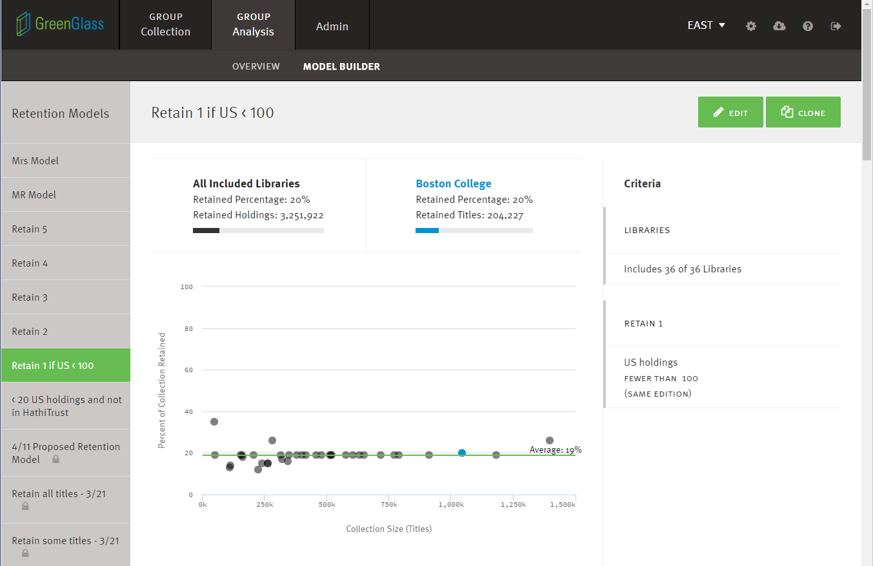
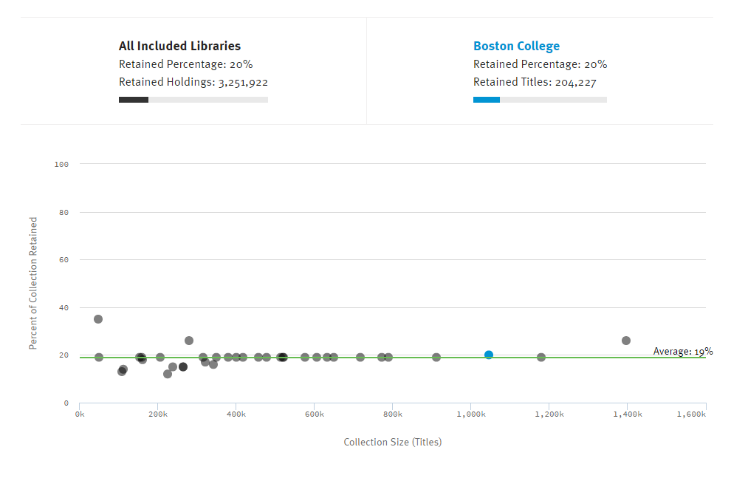
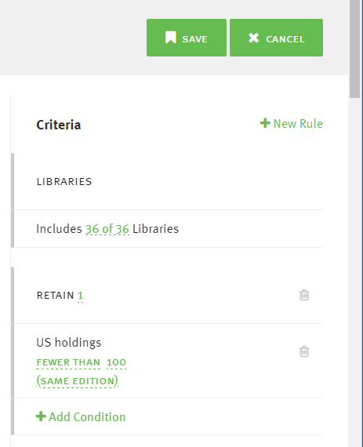
Notes:
Remember that GreenGlass Group Models are always retention focused.
You can watch a tutorial to see how to build them, so for today – I’m just going to show you some results. Navigational tabs on the left display the names of my saved models. Criteria for each model appear on the right. The scatterplot in the center of the screen displays the results of the model.
Each dot represents one of the libraries in the group. The x (or horizontal) axis represents library size, and the y (or vertical) axis represents the percentage of each collection that will be retained. As you add rules and conditions to your own models, you can watch the dots shift.
This is probably the simplest of all models wherein the group will retain 1 copy of all titles currently owned by the group. For MI-SPI, this would require that the group retain 59% of the shared collection, and each library would be required to retain approximately the same percentage of their own collection.

Slide 20
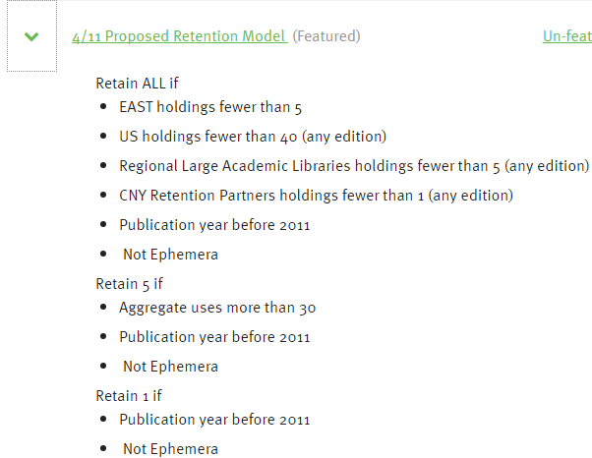

Slide 21
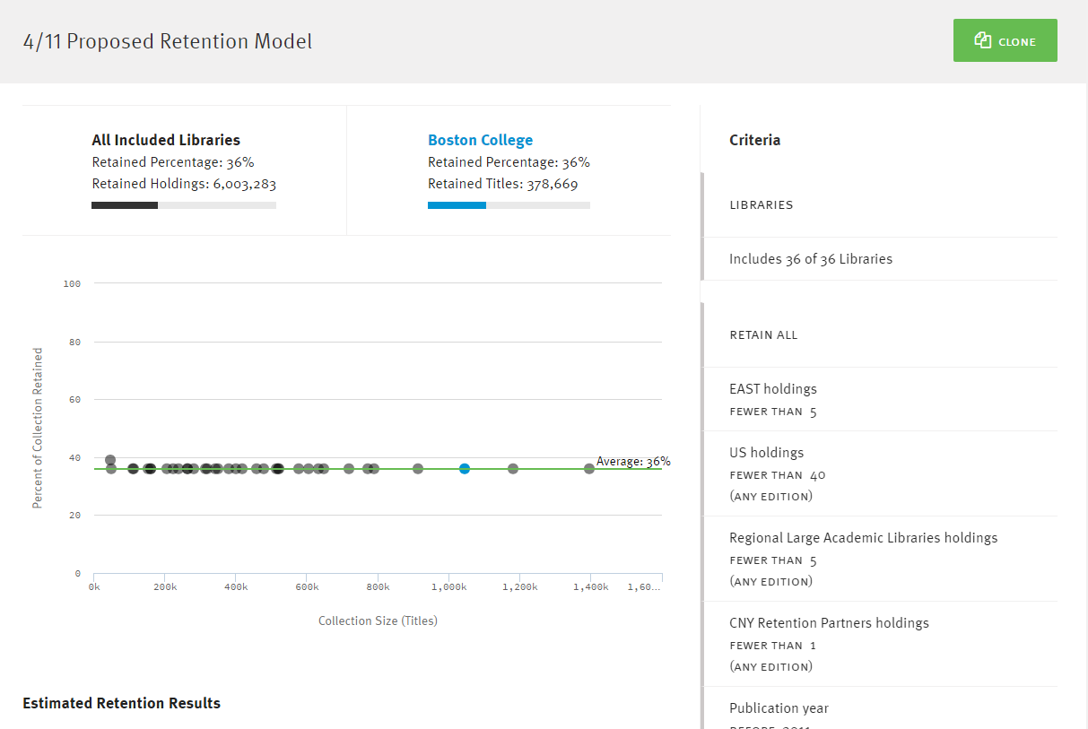
Notes:
Remember that GreenGlass Group Models are always retention focused.
You can watch a tutorial to see how to build them, so for today – I’m just going to show you some results. Navigational tabs on the left display the names of my saved models. Criteria for each model appear on the right. The scatterplot in the center of the screen displays the results of the model.
Each dot represents one of the libraries in the group. The x (or horizontal) axis represents library size, and the y (or vertical) axis represents the percentage of each collection that will be retained. As you add rules and conditions to your own models, you can watch the dots shift.
This is probably the simplest of all models wherein the group will retain 1 copy of all titles currently owned by the group. For MI-SPI, this would require that the group retain 59% of the shared collection, and each library would be required to retain approximately the same percentage of their own collection.

Slide 22
Retention Allocations and Beyond
Retention commitments are allocated to participant libraries
Retention commitments are flagged/integrated into GreenGlass so users can generate lists
Participant libraries secure their retained items and set retention holdings in WorldCat
Participant libraries use GreenGlass to weed surplus copies according to local needs and circumstances
Notes:
Once the group has come to consensus about a retention model …. subsequent steps in the process go something like this.

Slide 23
Thank you!
Ruth Fischer
Sustainable Collection Services/OCLC
fischerr@oclc.org

